Slide 1
Cypress and Playwright
Let’s look at limits

Slide 2

O mnie

Slide 3
Cypress and Playwright
Let’s look at limits

Slide 4
Agenda
The Project
Syntax
CI/CD
Config
Logging
Test Organization
Features needed for Project

Slide 5
Asking Which Framework is better is Wrong!
The right question is: Which suites our needs better?

Slide 6
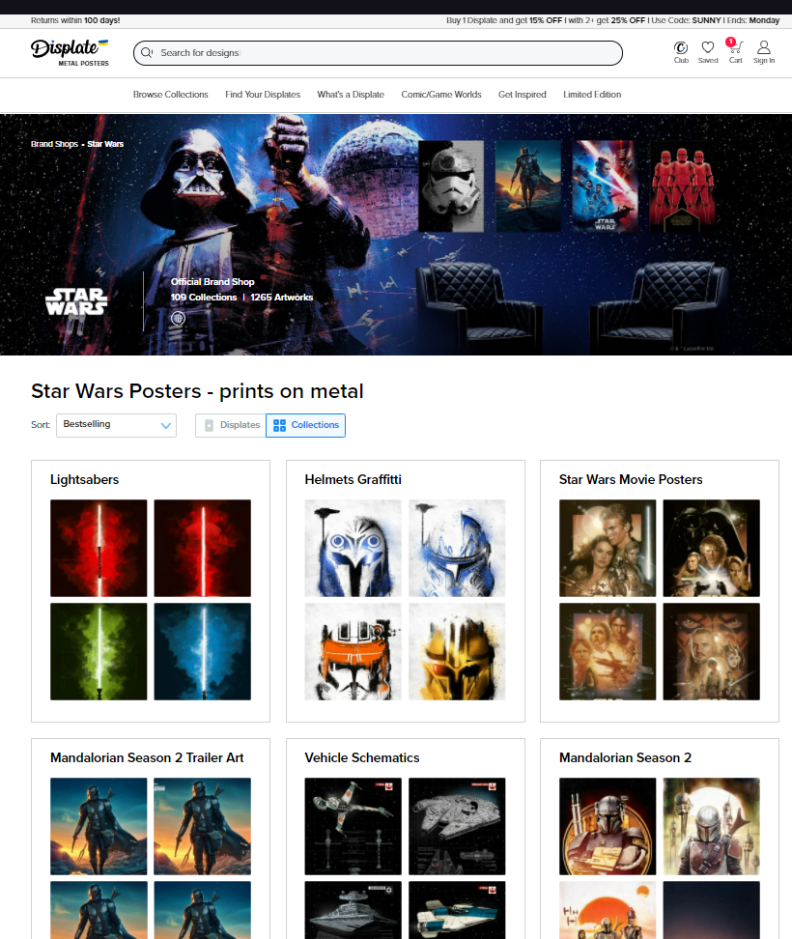
The Project - Displate Brand Control
Main Features:
Creation/Edition of “brands”
Creation of brand layout
Creation and Edition of collections
Management of artworks
Tags
Legal info
Region restrictions

Slide 7
Syntax
Test for Adding artwork to brand:
Test Preparation
Create brand via
Setup layout via api
Create Collection
Notes:
Why this way: Each tests should be run stand alone We dont want static test data
Test with mocs are done on different level

Slide 8
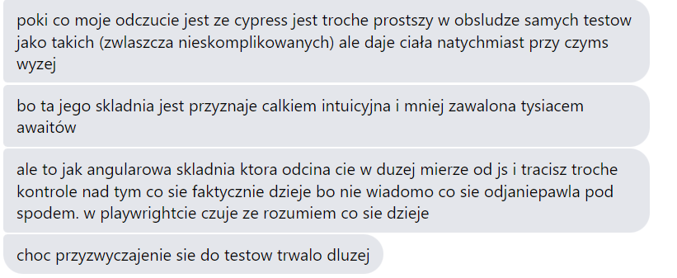

Slide 9
Logging

Slide 10
CI/CD

Slide 11
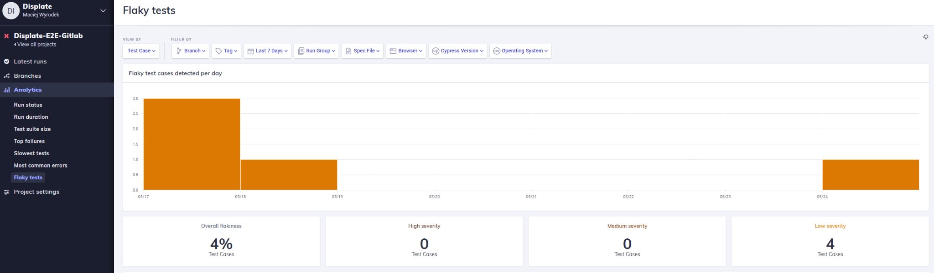
Cypress Dashboard is Cool!

Slide 12
Test Organziaton

Slide 13


Features
Supported Languages | JS, TS,C#, PYTHON | JS,TS
Runners | Build in runner, any JS unit test runner | Build in Runner (heavily modified Mocha)
Cross Domain Support | Yes | Yes, as of 9.6.0 in beta
Multitab | Yes | No
Access to system files | Yes | Yes* - mostly via fixtures, access to downloaded files only via plugin.
Extensibility |  | Yes - tons of ready too use plugins

Slide 14
Features
Drag and Drop | Yes | Yes (since 9.3.0)
Ease of Use | Steep learning curve | Easy to get into
Waits | Built into most of the functions | Extensive autowaits in almost all of operations
Parallel Execution | Yes, even on one agent | Only via Cypress Dashboard or similar solutions
Reporters | All unit test reports, allure reports | Cypress Dashboard, mocha reporter, custom reporters

Slide 15
Features
configs | PlaywrightTestConfig | cypress.json, env parameter, env variables staring with CYPRESS_
documentation | Technical Sometimes Hard To Read | Extensive documention not always well maintained
custom assertion messages | Yes (since 1.19) | By plugins
soft assertions | Yes (since 1.19) | no
iframe | Yes (since 1.17) | no
performance | Fast in CI/CD | Good local performance

Slide 16
We Choose Cypress
Only Novice level automation experience on team
Was already part of company tech stack
PoC showed there shouldn't be any roadblock
Great Documentation
Low Entry Level
“Easy” Setup

Slide 17
That Was wrong Choice

Slide 18
Questions?
Thank You

Slide 19
Sources
https://lambdageeks.com/cypress-promise-cypress-asynchronous/
https://medium.com/uk-hydrographic-office/why-we-chose-playwright-over-cypress-db4770cf5204
https://hughmccamphill.com/four-reasons-why-webdriverio-is-better-than-cypress
https://blog.checklyhq.com/cypress-vs-selenium-vs-playwright-vs-puppeteer-speed-comparison/
https://github.com/cypress-io/cypress-documentation/issues/4043
https://medium.com/tech-p7s1/why-favor-playwright-over-selenium-or-cypress-e96df84c08e1
https://playwright.dev/docs/release-notes
https://docs.cypress.io/guides/references/changelog
https://github.com/cypress-io/cypress/issues/7306#issuecomment-1034108000
https://chercher.tech/playwright-js/async-await-playwright

